Slide 1
Moving Past the Arduino IDE for Embedded Development

Slide 2
Abstract
Learn how to write embedded software with tools that aren’t the Arduino IDE
Learn how to work with C/C++ for embedded development

Slide 3
Speaker Bio
Al Rodriguez
.NET Dev for over a decade
Java Dev for the beginning of that
@ProgrammerAL on Twitter

Slide 4
Steps to Create an Embedded App
1) Type out the code
2) Compile to Native Instructions (8-bit ARM in our case)
With choice of compiler depending on language
3) Copy binary file to target board

Slide 5
Goal
Create an embedded app that can communicate over a radio
Not Wifi
Not Bluetooth
Custom RF signals
Create script to allow repeat:
Builds
Deployments
Unit Tests

Slide 6
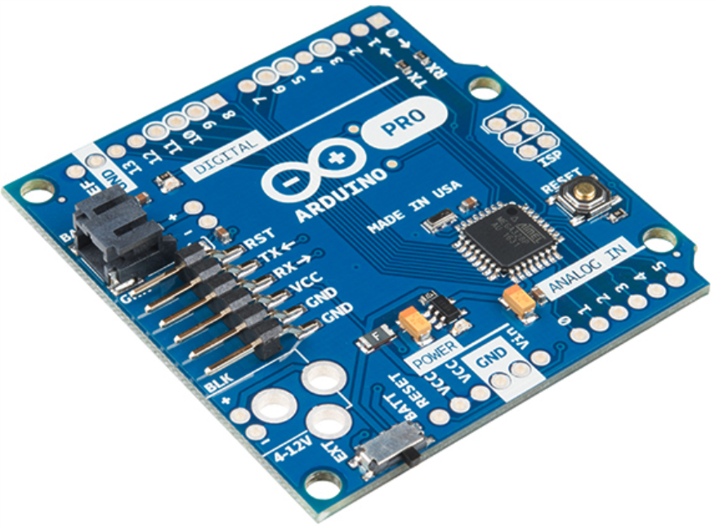
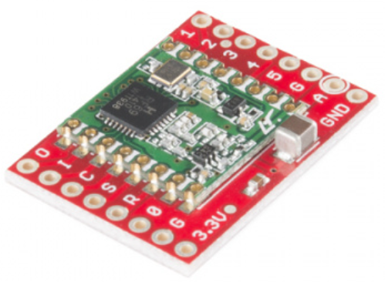
Hardware
Arduino Pro 328 – 3.3V
Sparkfun RFM69 Transceiver (915 MHz)

Slide 7
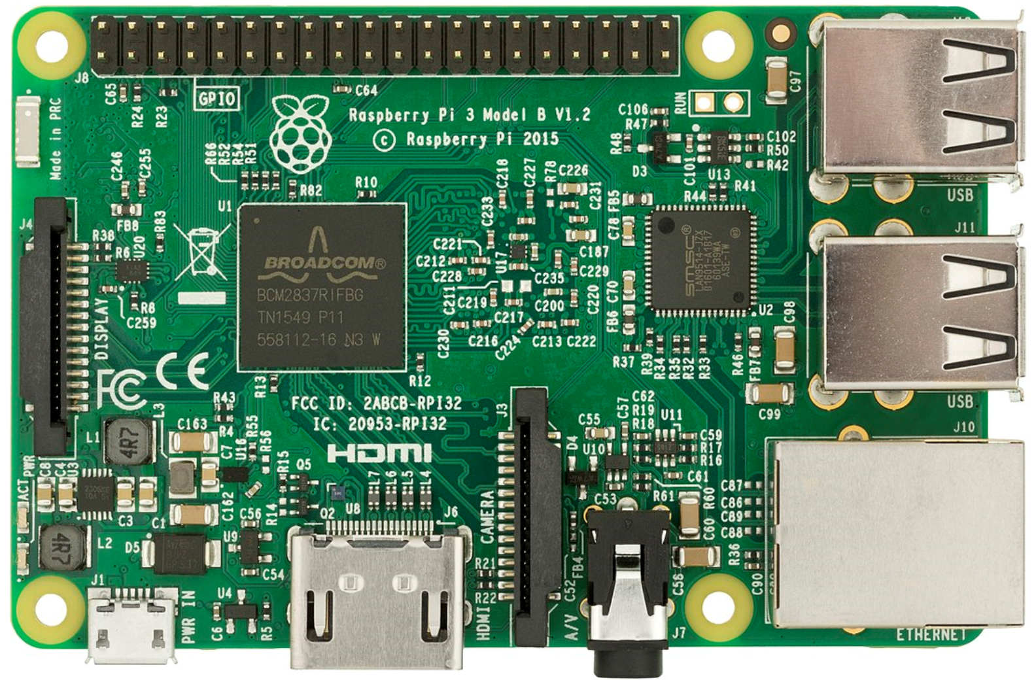
Extra Hardware
Raspberry Pi
Sparkfun RFM69 Transceiver (915 MHz)

Slide 8
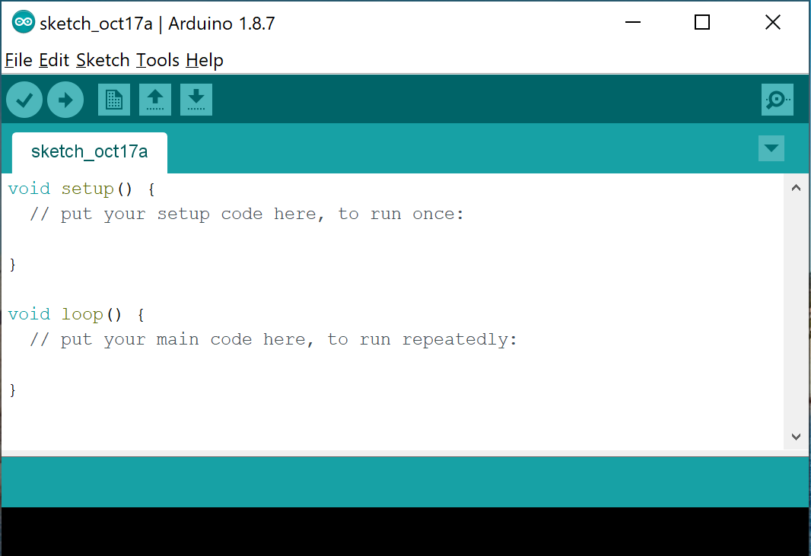
Arduino IDE
https://www.arduino.cc/
Pros
Easy to setup
Abstracts low level concepts
C and C++ under the hood
Adding external libraries is very easy
Cons
Built for prototyping
Proprietary project system

Slide 9
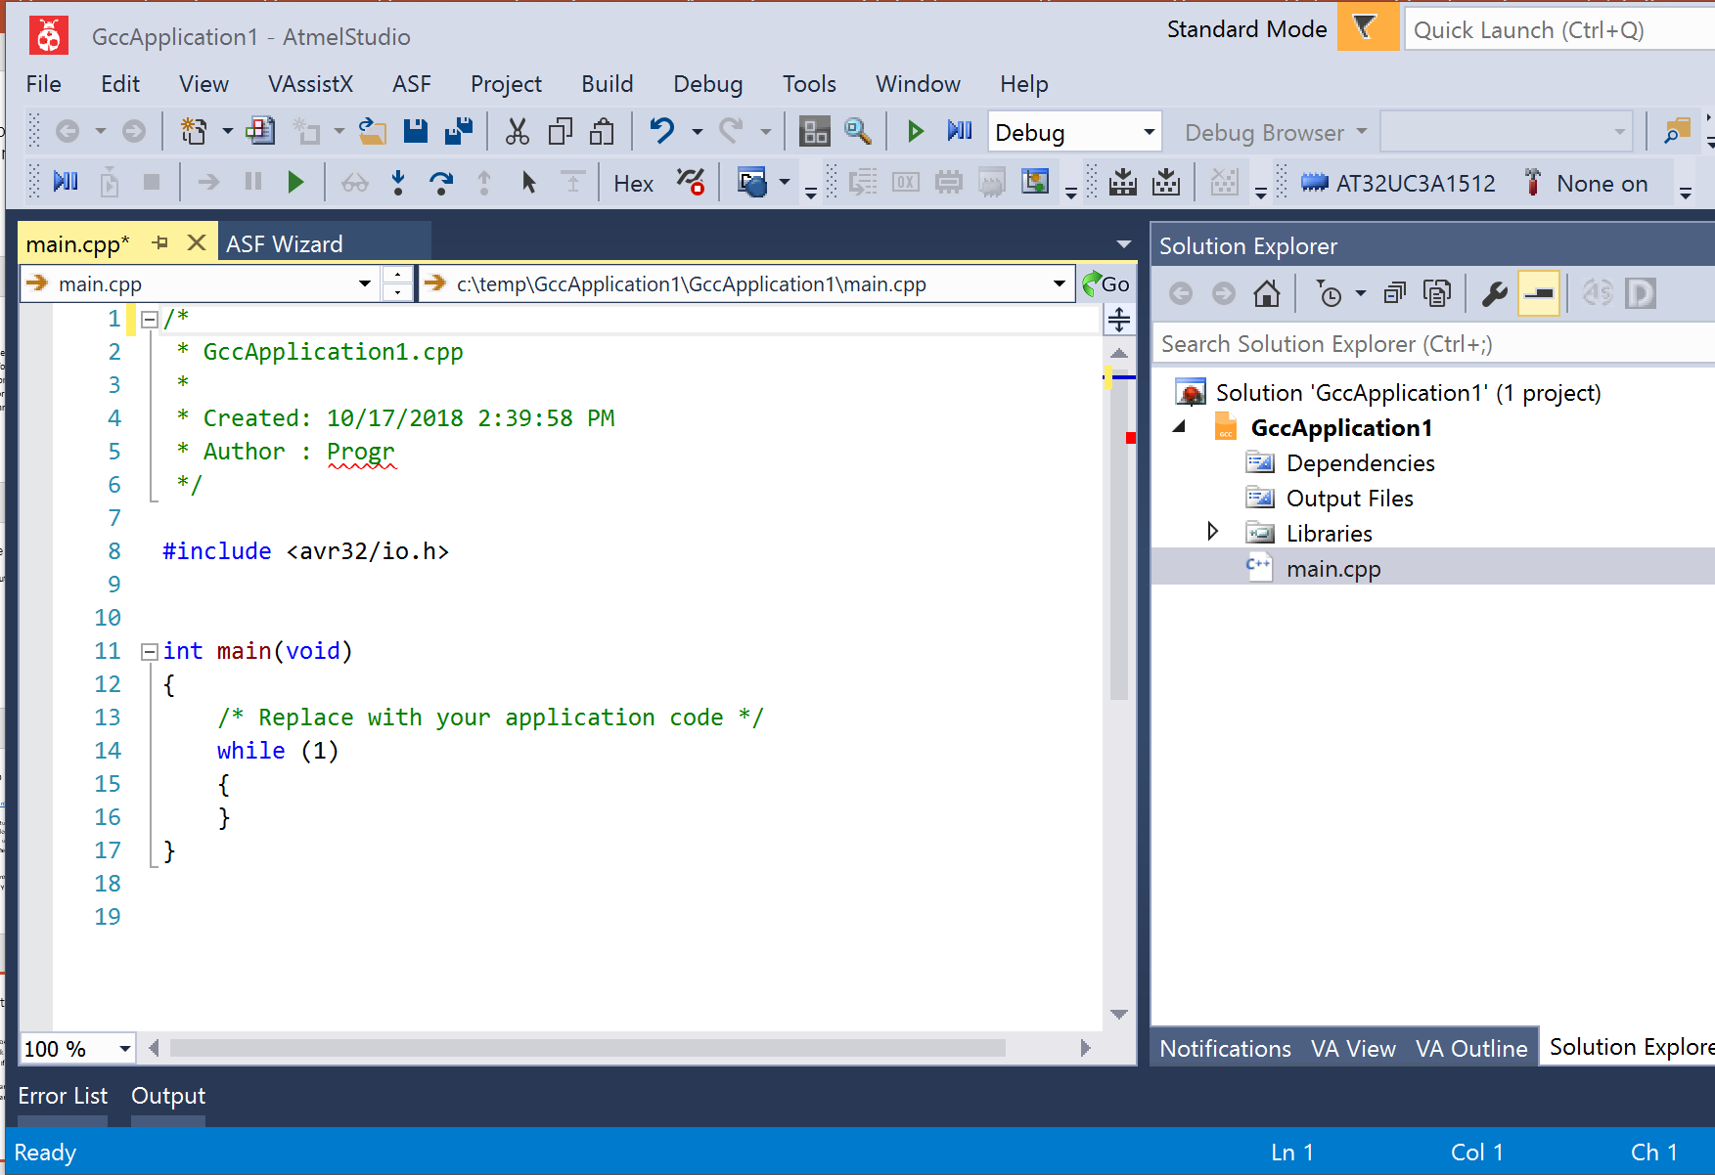
Atmel Studio
Pros
Lots of tools built in
Can work with C, C++, and Arduino projects
Familiar if you use Visual Studio
Cons
Some manual setup
Proprietary project system

Slide 10
Roll Your Own with CMake
Pros
Cross Platform
Cross IDE
Can add unit tests!!!
Cons
Lots of time to setup
Easy to lose cross-platform benefits

Slide 11
Other Systems
Arduino CLI
https://github.com/arduino/arduino-cli
Arduino IDE, but a CLI tool
Meant for scripting scenarios
IoTZ
https://github.com/Azure/iotz
Wrapper to other tools for working with embedded applications
One Stop Shop for embedded tooling
NPM Package

Slide 12
What’s Installed on the Machine
Arduino
Just for AVRDude. You may not need this for your projects.
Atmel Studio
AVR Toolchain
C/C++ compilers, linker, etc
AVR Standard Library
Note: Arduino IDE Installs this too
Atmel Studio has newer versions than what Arduino comes with
Visual Studio 2017
Include C++ features
Include Windows 8.1 SDK (for compiling unit tests to x86)
NMake
Installed by Visual Studio
CMake

Slide 13
Embedded C/C++ Gotchas
No stdlib
Missing a lot of features you’re used to
‘new’ keyword
Can make your own or find them online
Trickery involved in getting unit tests created/run
Can’t debug unit tests easily
Even though they’re compiled for x86

Slide 14
Cmake Gotchas
Manually add/remove files included in compilation
Variable scope/lifetime

Slide 15
What else to look into?
Debuggers
They exist!
No idea how they work…
Other build systems for C/C++
https://medium.com/@julienjorge/an-overview-of-build-systems-mostly-for-c-projects-ac9931494444
Rust Language?
Found a compiler somewhere on the internet to generate AVR. Not officially supported.

Slide 16
Other Resources
ATMEL AVR Microcontrollers book
Starts out with a great description embedded development in general
https://www.amazon.com/Programming-Interfacing-ATMELs-Thomas-Grace/dp/1305509994

